Slide 1




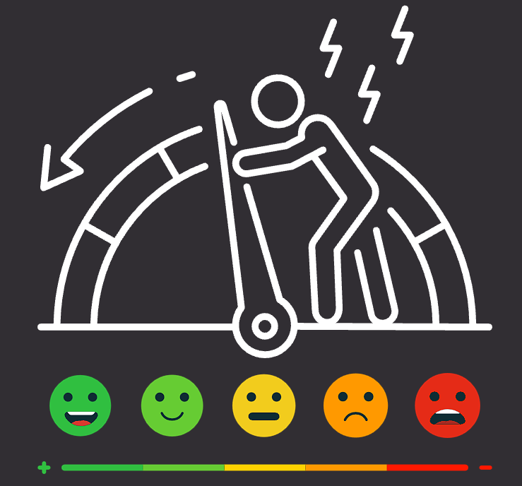

TEAM 01 - ANKIT KUMAR
Human Stress Detection & Prediction
Using ANN
Team Members:
Ankit Kumar - (Team Leader)
Kishore Batchala
Sheggari Pooja Goud
Amrutha Tamada
Anand Panda
Meera Iswar
Naga Sai Ganesh

Slide 2

Project Introduction

Slide 3
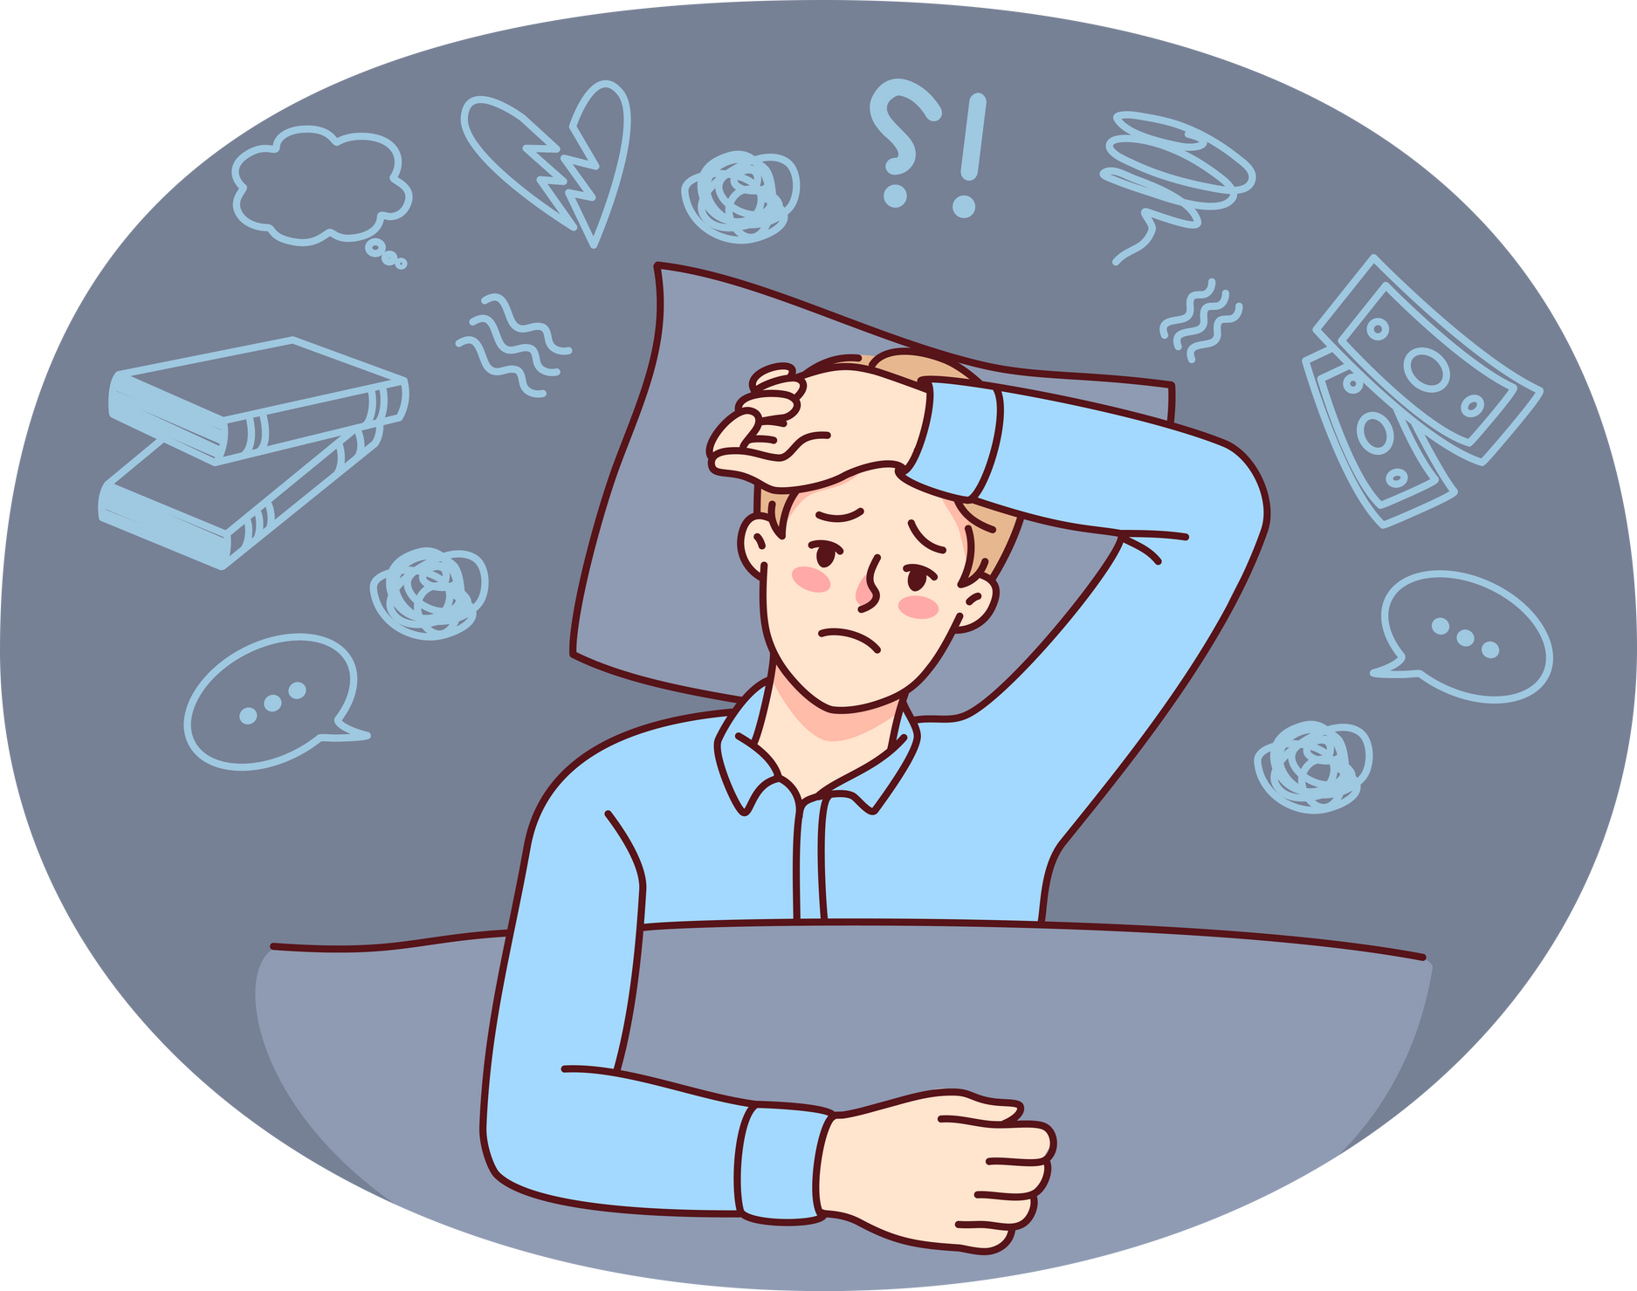





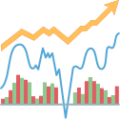

Project Introduction
Human Stress Detection and Prediction
“Stress is a critical health concern in today’s fast-paced world. Stress leads to severe health problems, including anxiety, and even reduced Human Productivity. Yet, it’s often overlooked. With this project, Our goal is to create a proactive tool that allows individuals to monitor and manage their stress effectively, starting with their Stress Prediction”
Objective
“This project’s goal is simple yet impactful: to predict human stress levels during sleep using physiological data such as heart rate, respiratory rate, body movements & More. By leveraging the power of Artificial Neural Networks, we classify sleep data into two categories: ‘Stressed’ or ‘Not Stressed.’
Tools and Technologies
Programming Language: Python
Framework: Django
IDE: Visual Studio Code
Model Type: Artificial Neural Network (ANN)
Data Visualization: Matplotlib, Seaborn

Slide 4

Project Overview
Project Uses
This project offers an accessible tool for stress monitoring, helping individuals to proactively understand and manage their stress levels. It serves as a practical application for everyday health management and preventive care.
User Tour
A Django-powered web app serves as the main interface, where users can:
Log in to access their personalized dashboard.
Input Health Data including parameters such as Snoring Rate, Respiratory Rate, Body Temperature, Limb Movement, and more.
Receive Stress Prediction Results generated by the ANN model, enabling them to track and manage stress effectively.

Slide 5

Project Milestone
Data Preprocessing & Visualizations
ANN Model Design & Architecture
Model Training and Visualization
Model Deployment
Preprocessed and cleaned data for accurate analysis. Used visualizations like bar charts, correlation matrices, and pair plots to uncover relationships among variables.
Designed the ANN model, with structured layers tailored to the input parameters, enabling robust stress level predictions.
Trained the model on the dataset, optimized hyperparameters, and visualized the training process with metrics like accuracy and loss to track model performance.
Deployed the ANN model within the Django application, creating a seamless user experience where predictions are generated in real-time based on user inputs.
Milestone - 01
Milestone - 02
Milestone - 03
Milestone - 04

Slide 6

Milestone - 01
Data Preprocessing & Visualizations

Slide 7
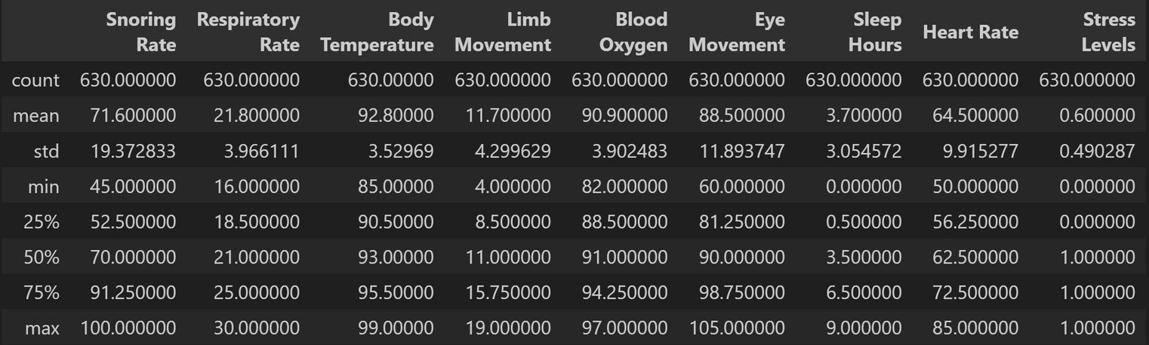
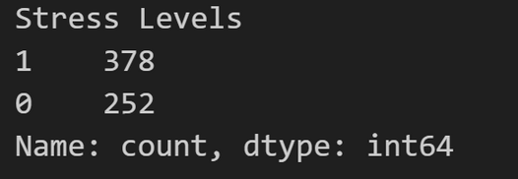



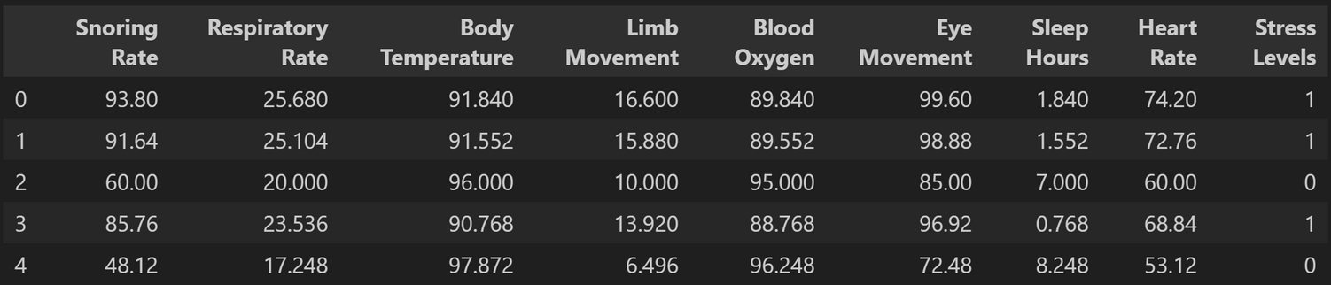
Data Preprocessing & Visualizations
Dataset Description
“This was the foundational step. We worked with physiological data recorded during sleep, such as heart rate, respiratory rate, and body movements. The data was cleaned, normalized.
Also Performed Standard Scaling On the Dataset.
To understand the dataset better and uncover hidden patterns, we created visualizations using Matplotlib and Seaborn. These helped us gain insights into the relationships between features and their impact on stress results.
Dataset Source
Kaggle: Sleep Stress Parameters

Slide 8
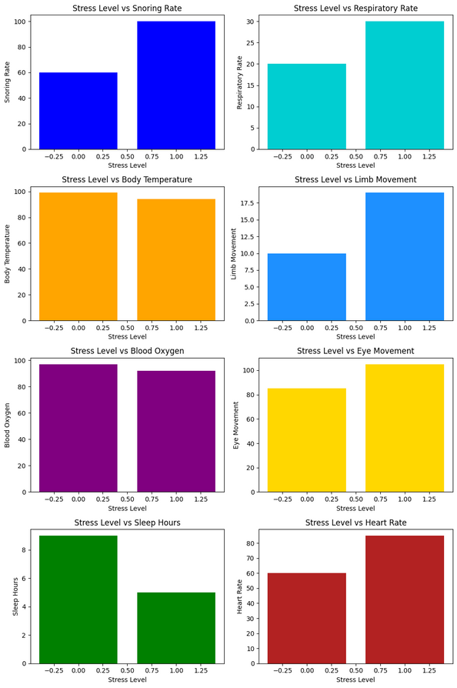
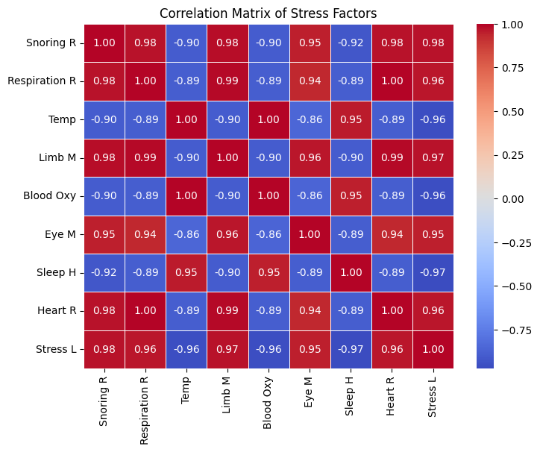
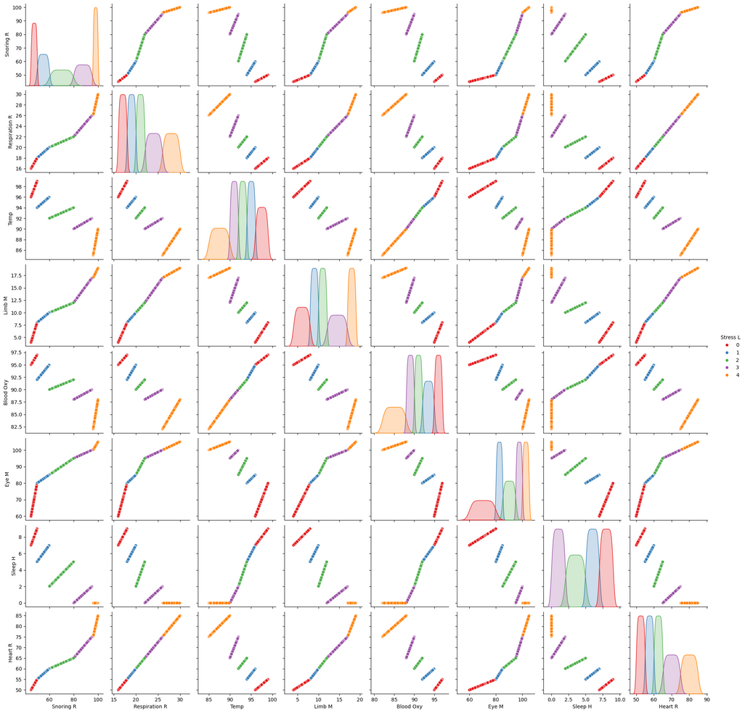

Data Preprocessing & Visualizations
Correlation Matrix : Heatmap
Pairplot
Bar Chart
3/5
Plots

Slide 9
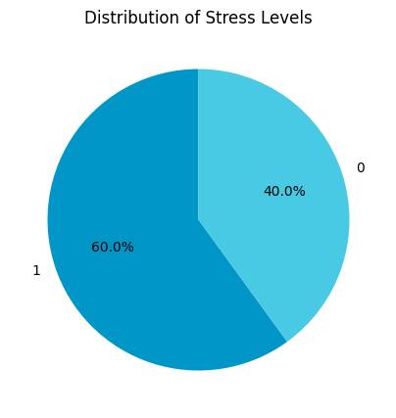
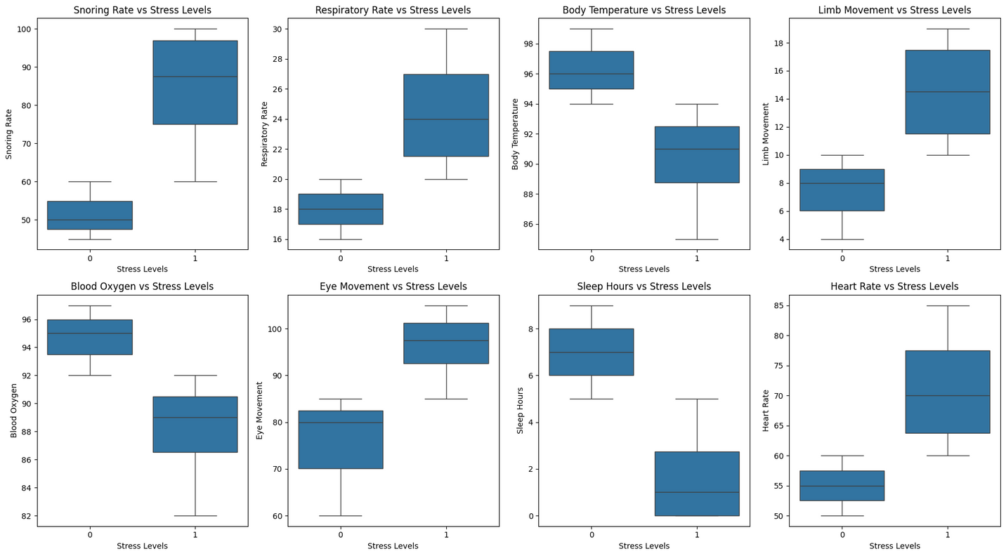
Data Preprocessing & Visualizations
Pie Chart
Boxplot
5/5
Plots

Slide 10
Milestone - 02
Artificial Neural Network (ANN) Model Design

Slide 11
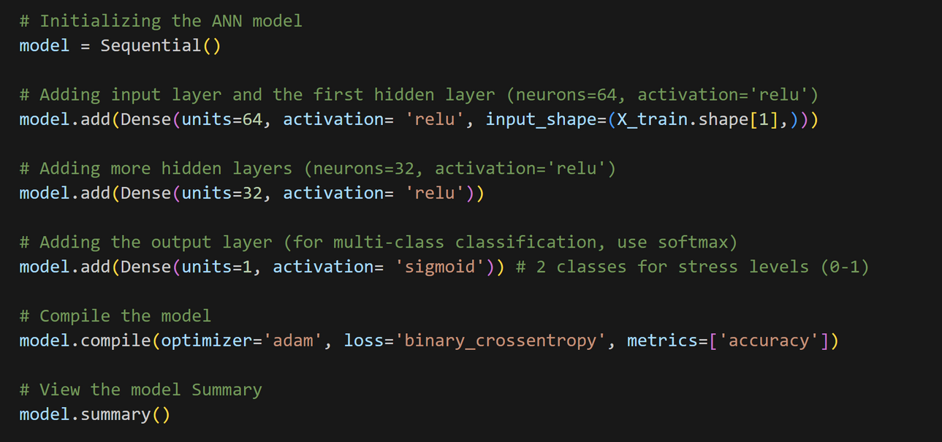
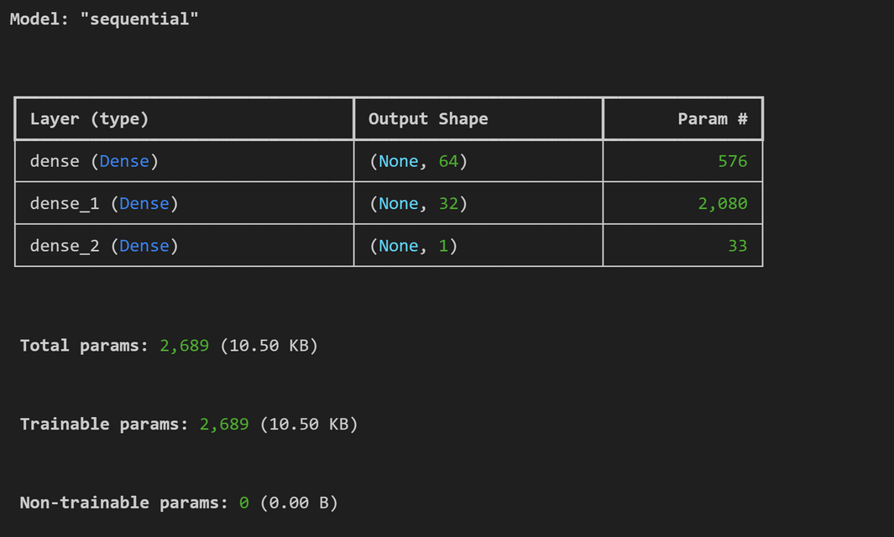
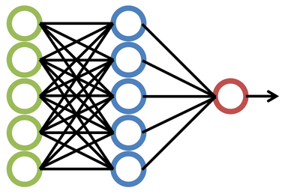
Artificial Neural Network (ANN) Model Design
Let’s start with a quick overview of the model’s architecture. This ANN is designed for binary classification, which means it predicts one of two possible outcomes: either Stress (0) or Not stress (1) based on various input features such as snoring rate, body temperature, heart rate, and others. Our model has three main components: the input layer, the hidden layers, and the output layer.
“ The ANN architecture consisted of:
Input layer: Accepting multiple health parameters like heart rate and respiratory rate.
Hidden layers: Implementing non-linear transformations to capture complex patterns in the data.
Output layer: A binary classifier that predicts either ‘Stressed’ or ‘Not Stressed.’

Slide 12
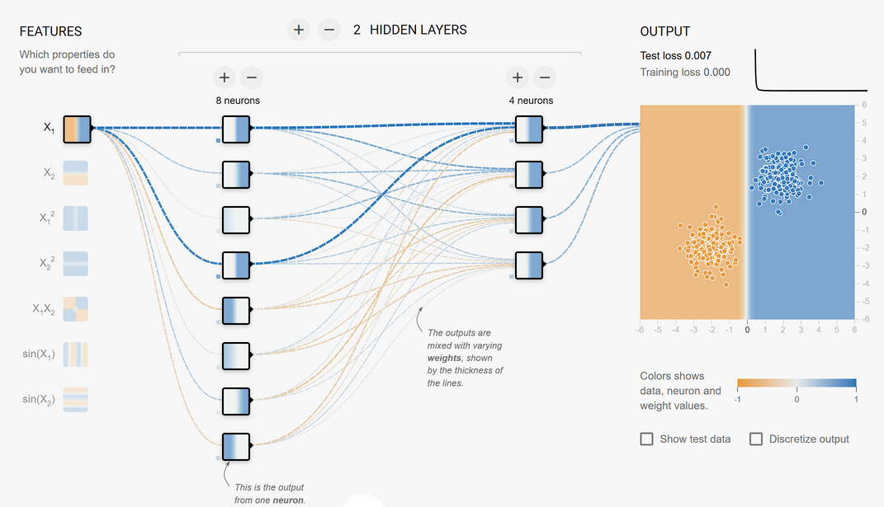
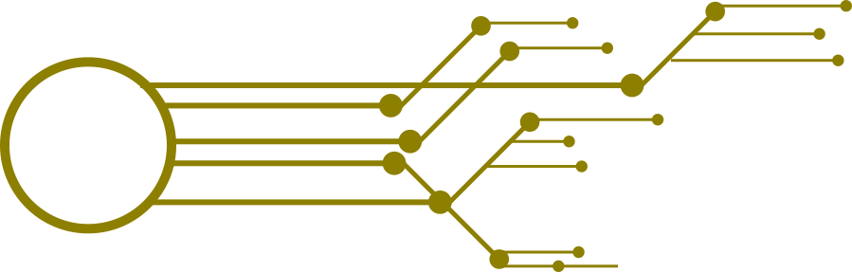
Artificial Neural Network (ANN) Model Design
Compilation of the Model
we compile the model using the Adam optimizer.
The Adam optimizer adjusts the weights of the model to minimize the loss function during training.
The loss function we use is binary cross-entropy, which is suitable for binary classification tasks like ours.
To measure performance, we track the accuracy of the model during training, which tells us how many predictions were correct.
ReLU (Rectified Linear Unit) activation function, which is a popular choice because it allows the network to learn non-linear relationships, making it ideal for complex datasets like ours.
Sample Neural Network

Slide 13
Milestone - 03
Training and Evaluation with Visualization

Slide 14
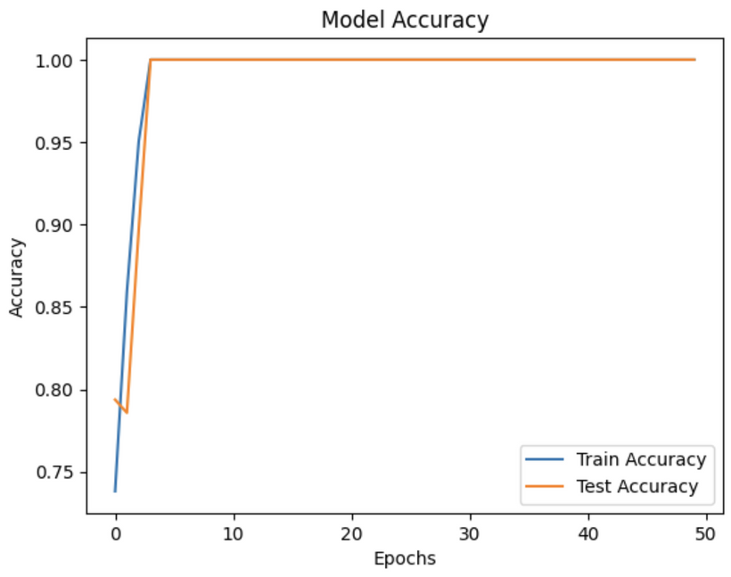
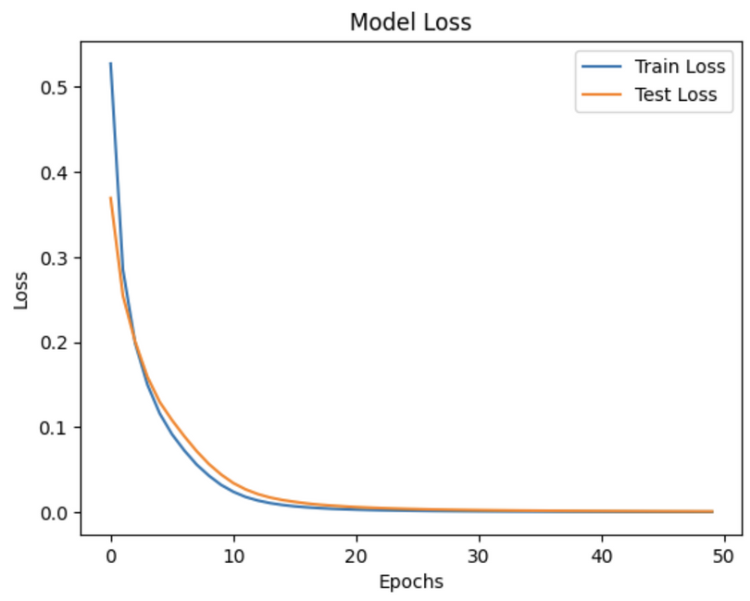

Training and Evaluation with Visualization
“ The ANN model is trained using the training data. The model runs for a defined number of epochs:
During training, We monitored metrics like accuracy and loss.
Visualizations, such as training progress graphs, helped track improvements over each epoch.
Once trained, the model achieved impressive performance metrics, including high precision.”
In conclusion, the training and evaluation process confirms that our model is accurately predicting stress levels

Slide 15
Milestone - 04
Model Deployment

Slide 16




Model Deployment : Django
• Framework : Django
“Finally, We deployed the trained model into a Django-based web application. The web app offers a seamless user experience where individuals can:
Log in securely.
Input their physiological data.
Instantly receive their stress prediction, along with insights into contributing factors.
This step made the project accessible and actionable, bridging the gap between technology and real-world application.”
• Why Django?
Django is a high-level Python web framework.
Rapid Development: Django allows quick development of web applications with its out-of-the-box features.
Scalability: Designed to scale seamlessly with growing application demands.
Built-in Features:
User authentication system.
Admin interface for database management.
Middleware for security, such as CSRF protection.
ORM Support: Simplifies database queries with an object-relational mapper.

Slide 17
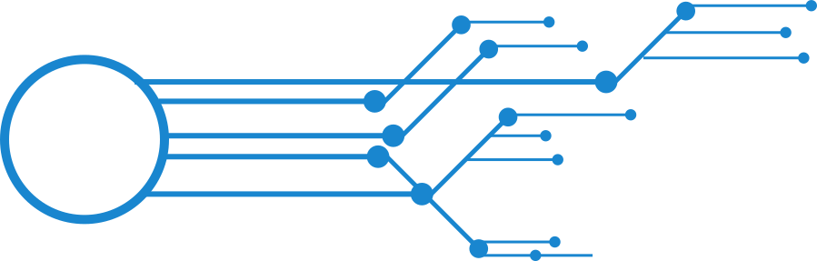

Model Deployment : Django
Working: API Endpoints and Data Flow
1. Login/Registration API:
User credentials are submitted and matched or registered in the database.
Upon successful authentication, a user session and CSRF token are created.
2. Data Entry and Submission API:
Accepts user inputs for prediction.
Validates and stores the data in the database.
3. Prediction API:
Processes the submitted data using the trained Artificial Neural Network (ANN) model.
Returns the prediction and redirects to the result page.
• Data Flow
Data Flow:
User -> Login/Register API -> Data Entry API -> Processing (ANN Model) -> Predict API -> Result Page

Slide 18
Database: SQL Implementation

Slide 19


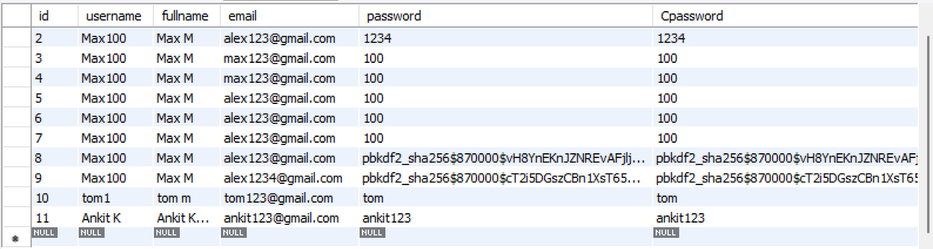
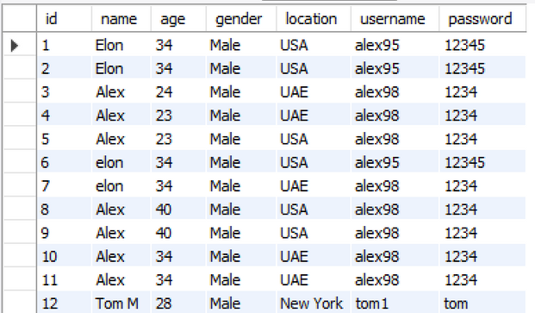
Database: SQL Implementation
• Database : SQL
Database Overview:
MySQL is used as the database management system for structured data storage and efficient retrieval.
For database, We implemented MySQL. Which Store User Data Like:
Sign Up
Login
User Information
Stress Prediction Inputs
Stress Prediction Result
Signup Database
Login Database

Slide 20
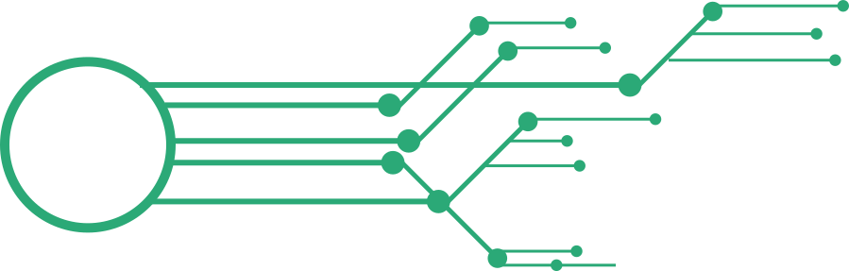

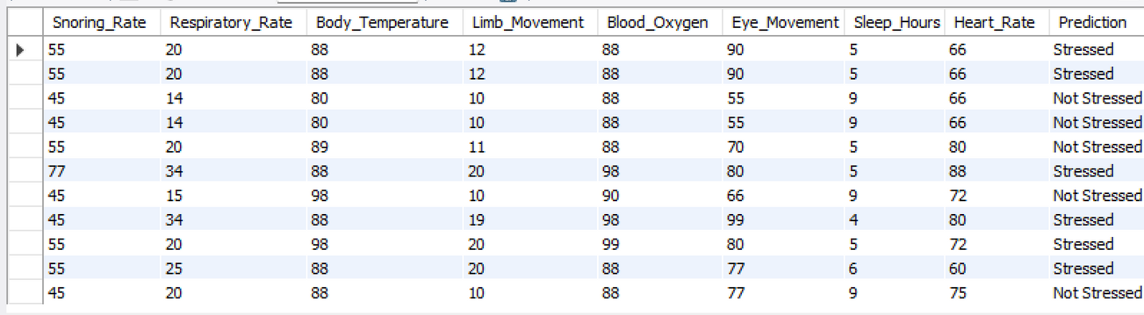
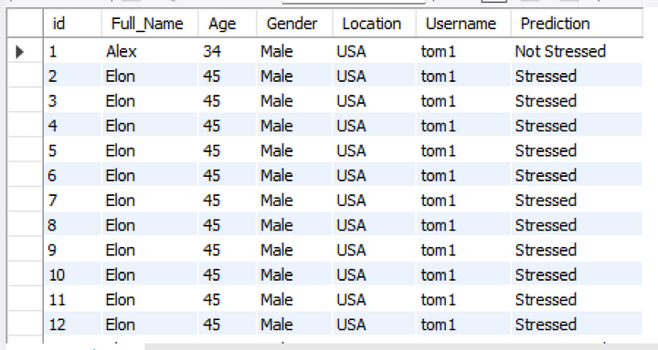
Database: SQL Implementation
• Database : SQL
Integration:
The application interacts with the MySQL database using SQL queries for data insertion, retrieval, and update operations.
Seamless integration ensures real-time data flow between the web app and the database.
User Authentication: Handles Sign Up and Login operations securely.
User Information: Stores personal details such as name, age, gender, and location.
Stress Prediction Inputs & Results : Records the health parameters provided by users for stress level prediction.
Stress Data Input & Result Database
User Info & Stress Result Database

Slide 21
User Interface & Tour
Presenter
(Ankit Kumar - Team Leader)

Slide 22
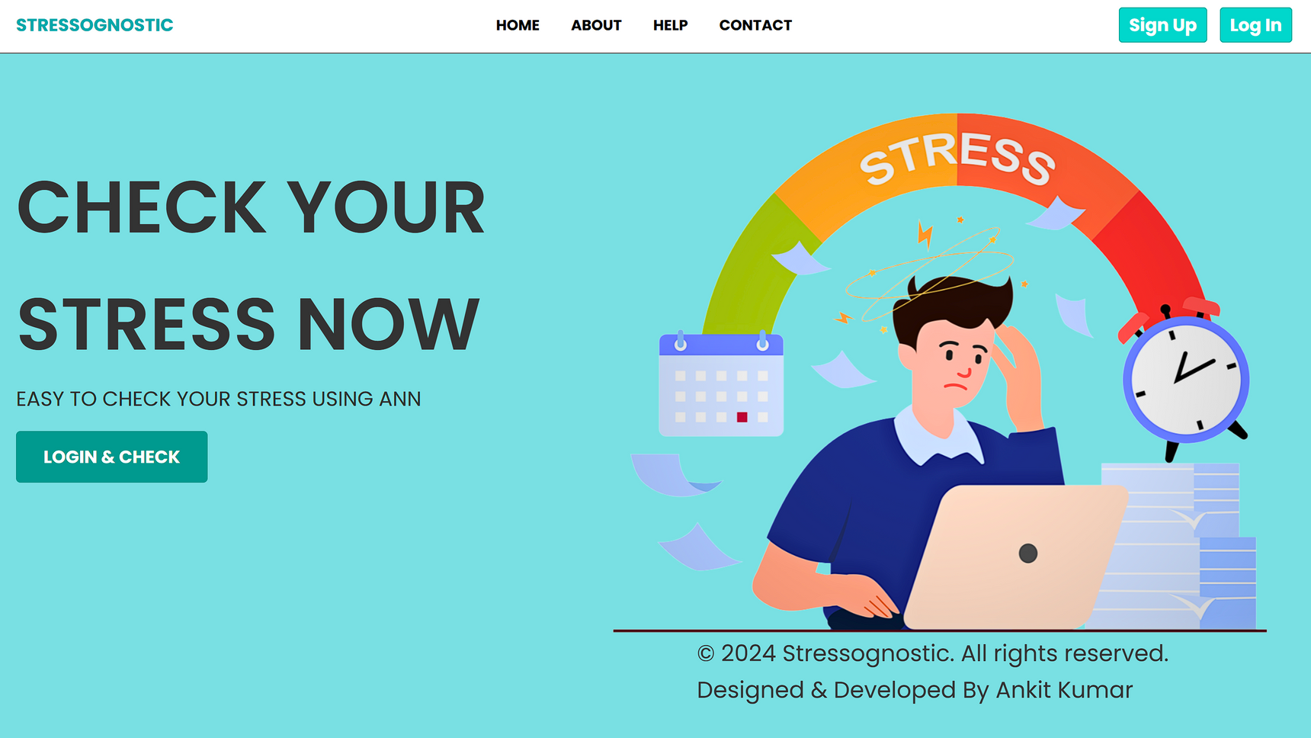
Home Page
This is the Home or Landing page of our Website. Here Explore different sections Like: About, Help & Contact. You Can Directly Login and Sign Up from the Home.

Slide 23
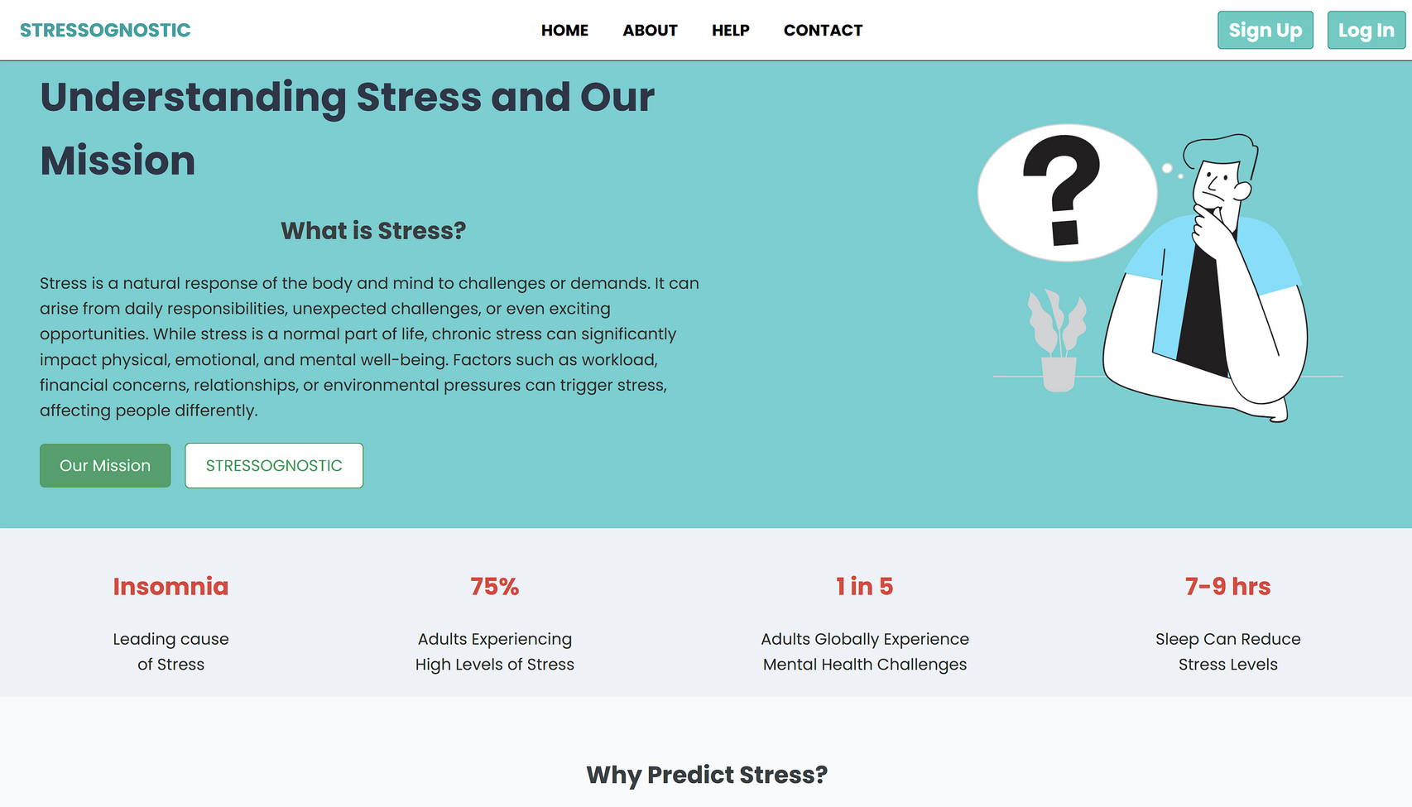
About Page
This "About Page" of "Stressognostic" website introduces its mission to help users understand stress and its impacts. It defines stress as a natural response to challenges and highlights how chronic stress can affect mental, emotional, and physical well-being.

Slide 24
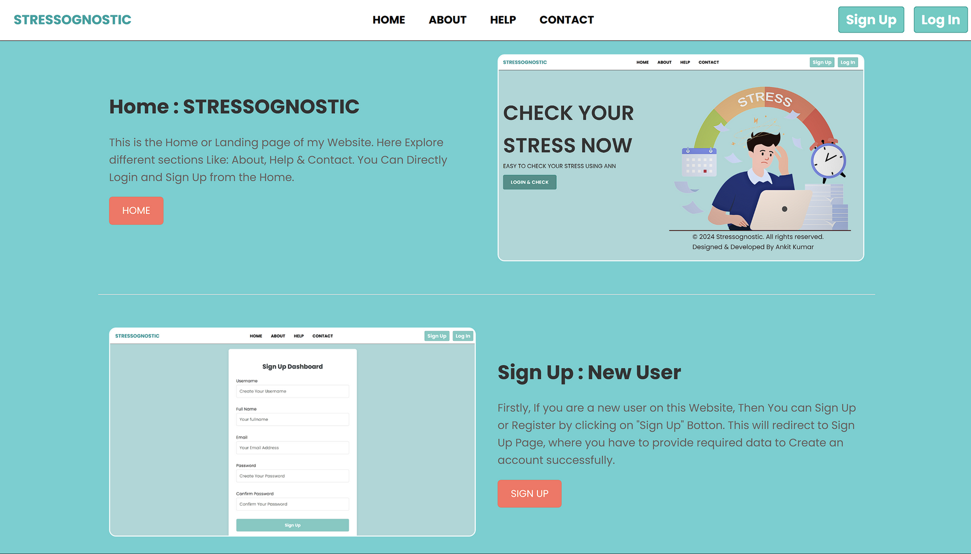
Help Page
This "Help Page" of the Stressognostic WebApp provides a user-friendly guide for navigating and utilizing the platform.
enabling users to evaluate their stress levels easily. Additionally, it includes a step-by-step guide for new users to create an account through the Sign-Up Dashboard, ensuring a seamless onboarding process.

Slide 25
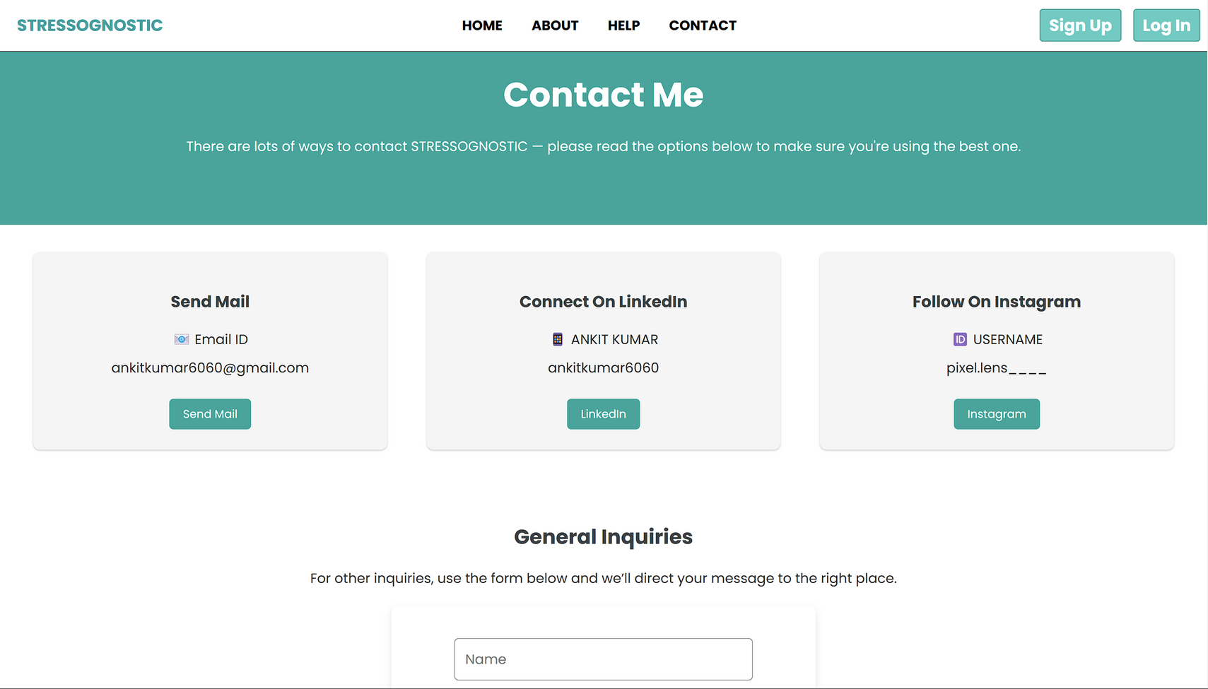
Contact Page
The "Contact Page" of the Stressognostic WebApp offers multiple ways to connect for support or inquiries. Users can reach out via email, LinkedIn, or Instagram for updates. Additionally, a general inquiry form is available for personalized messages. This page makes it simple for users to interact with the developer or seek help directly.

Slide 26
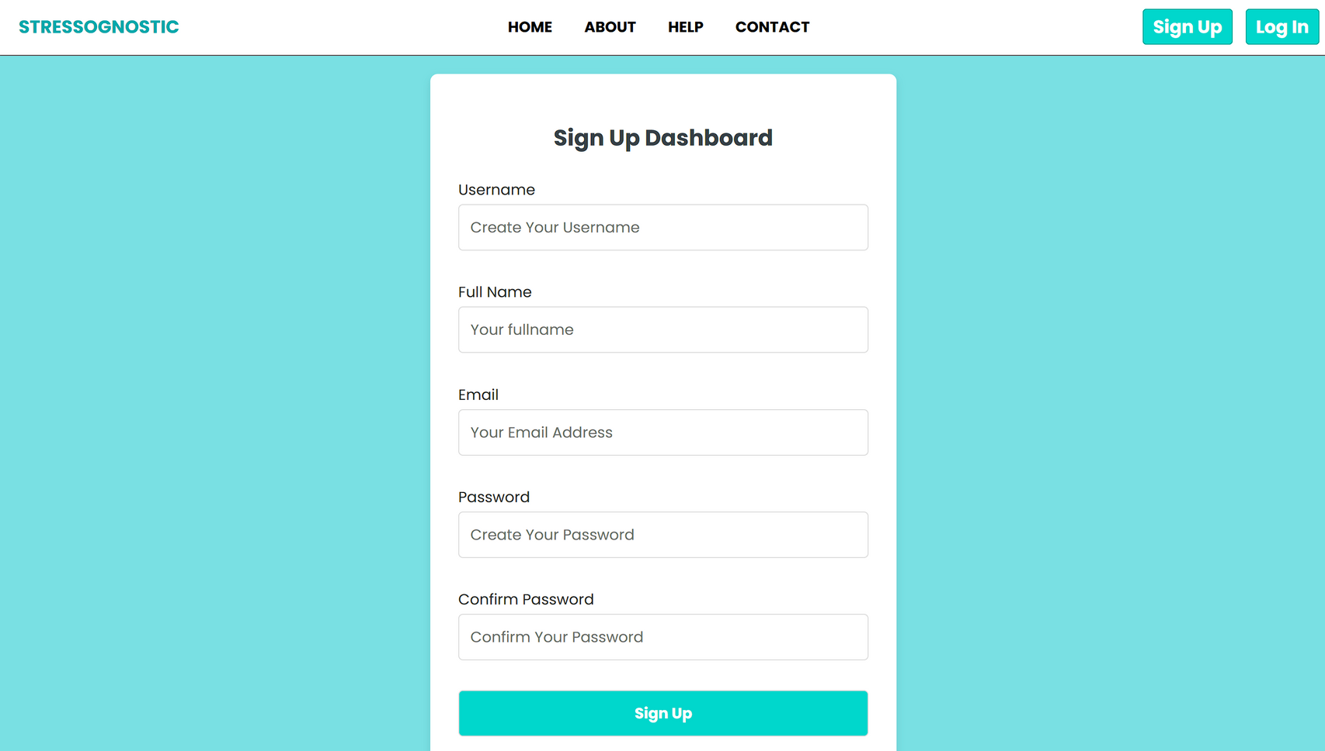
Sign Up Page
Firstly, If you are a new user on this Website, Then You can Sign Up or Register by clicking on "Sign Up" Botton. This will redirect to Sign Up Page, where you have to provide required data to Create an account successfully.

Slide 27
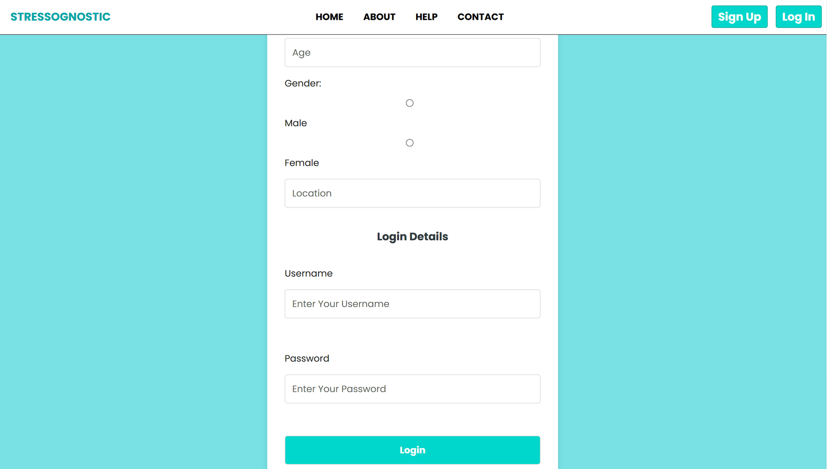
Login Page
After SignUp/Existing User Can Login into their account. For Login You have to provide some Personal Information and then Login - Username & Password for Successful Login into your account.

Slide 28
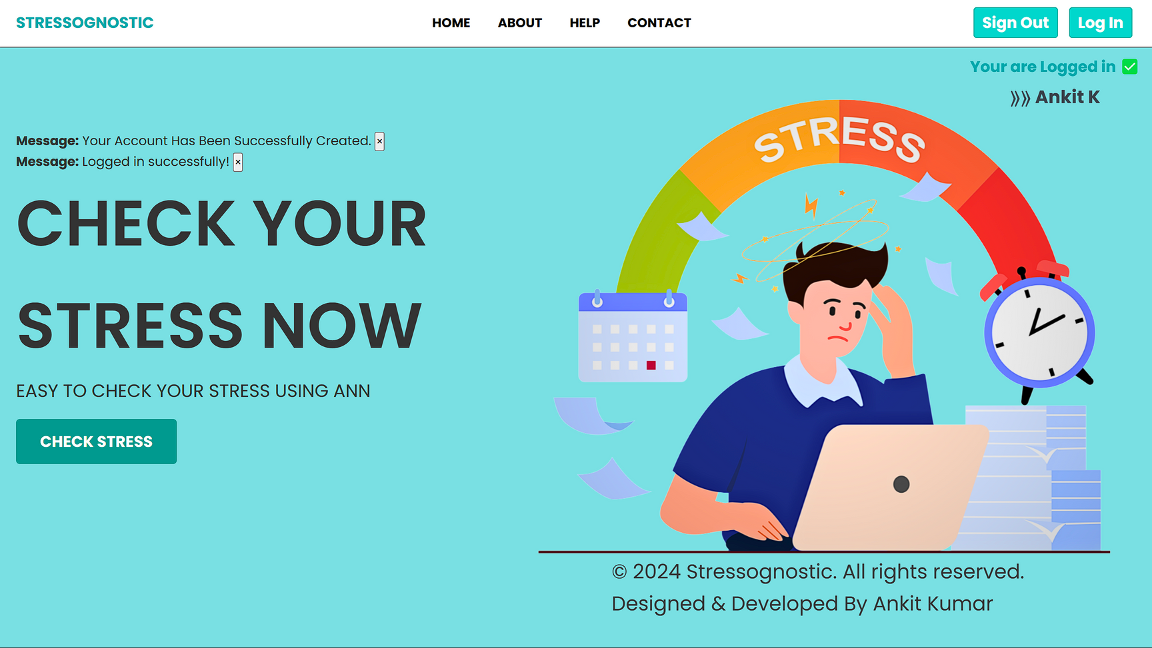
Home Page: After Login
After Successful Login You will redirect to Home Page with Logged in Home, Where your Username will Show and Stress Check Botton will Available & Click to Check Stress.

Slide 29
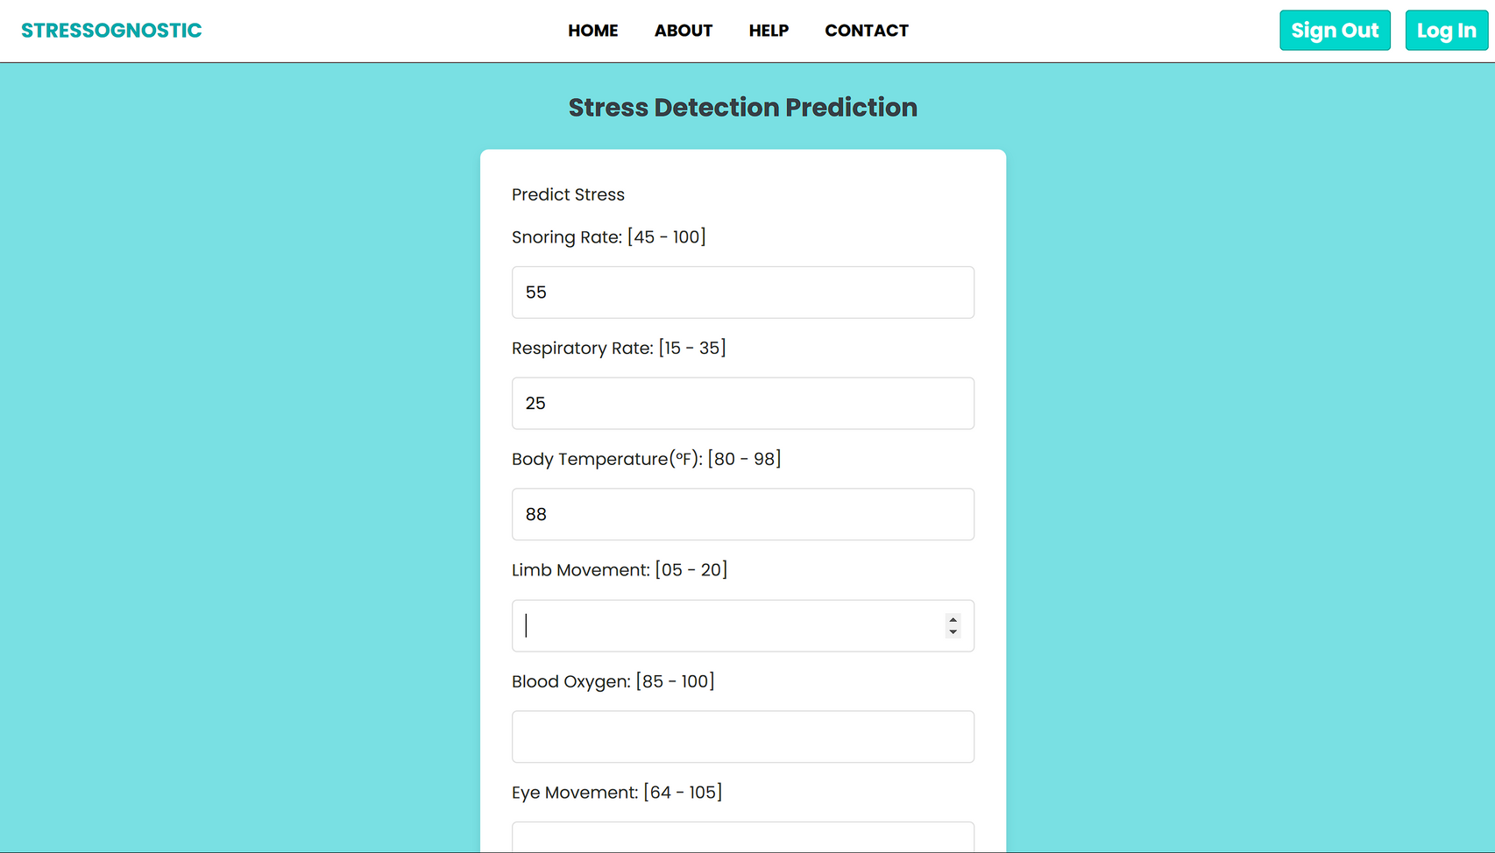
Check Stress: Data Input
To Check Your Stress, Input Your Stress Parameters data Like: Respiration, Sleep, Movement etc. Then You have to just Click on "Predict Stress Level" & You will redirect to your stress result Dashboard.

Slide 30
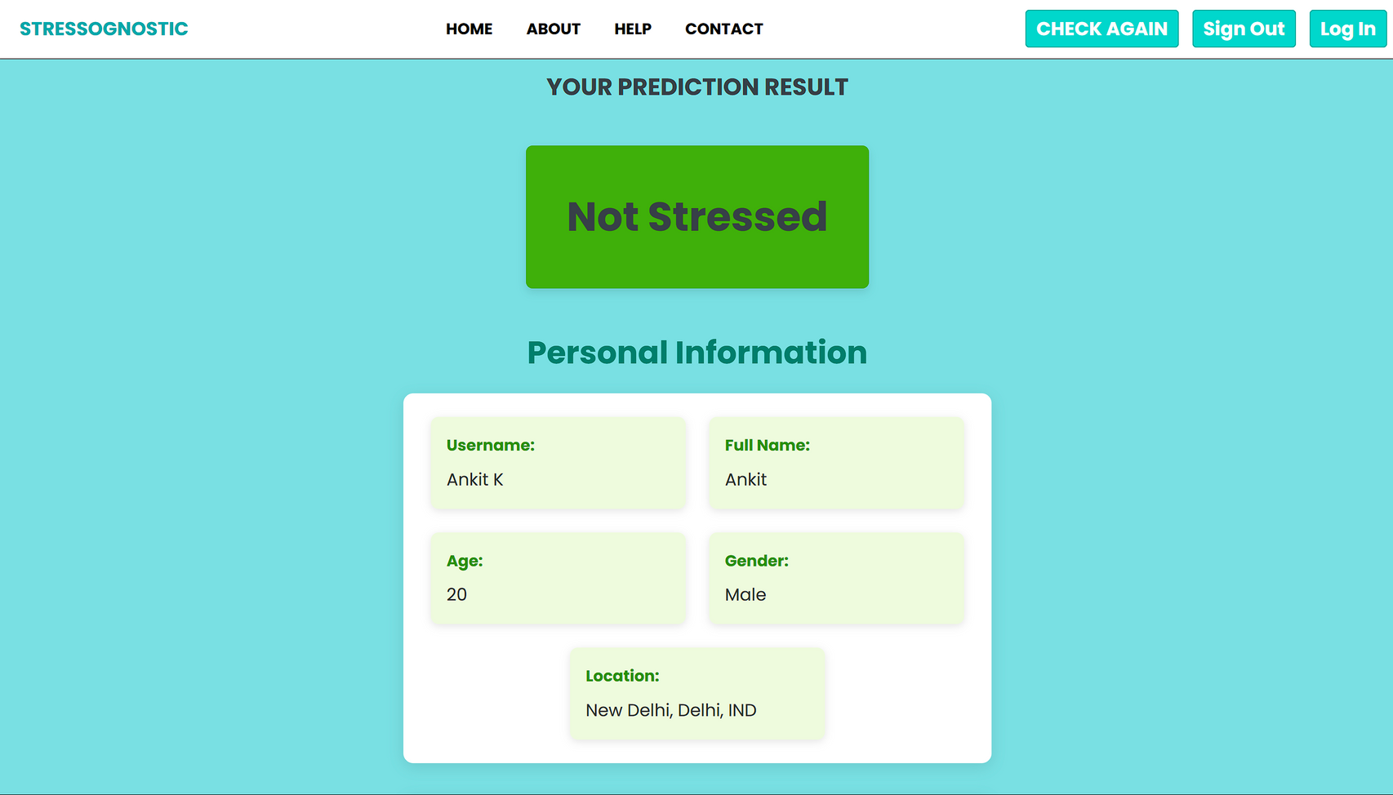
Stress Result: Not Stressed
After Input data If You are "Not Stressed": Then this interface will show along with Personal Information. You Can Recheck You Stress Using Above "Check Again" Button. You can scroll to get some suggestions to Stay Calm and Stress Free.

Slide 31
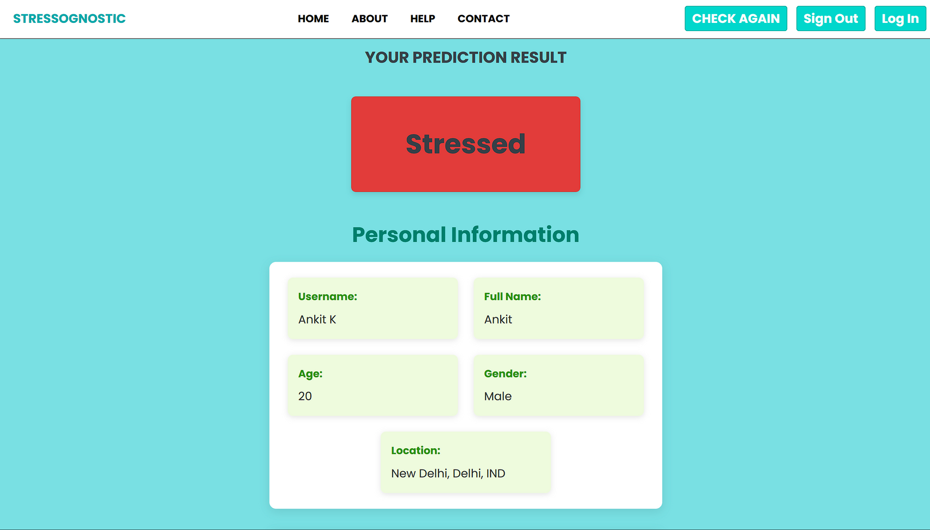
Stress Result: Stressed
After Input data If You are "Stressed": Then this interface will show along with Personal Information. You Can Recheck You Stress Using Above "Check Again" Button. You can scroll to get some suggestions to Stay Calm and Stress Free.

Slide 32


Team Contributions
1. Ankit Kumar (Project Team Leader)
Front-end & PPT Documentation
The Worked on Web App design and Implementations, handle the project management and Prepared the PPT Documentation. (Contributed as a Team Leader)
2. Sheggari Pooja Goud
Project Preparation & Management
Contributions in Project Preparation and their management, Milestone Management, Helped in project Introduction and Problem statement.
3. Kishore Batchala
Data Preprocessing & Visualizations
worked with physiological data recorded, cleaned them and performed Data Visualizations to gain insights from dataset.

Slide 33

Team Contributions
4. Amrutha Tamada
Artificial Neural Network (ANN) Model Design
Worked on ANN Model Architecture: designed the Artificial Neural Network and Compile it and summarize the model.
5. Naga Sai Ganesh
Training and Evaluation with Visualization
Trained The ANN model using the training data. The model runs for a defined number of epochs and Visualize the Train Accuracy and Loss.
6. Anand Panda
Model Deployment
deployed the trained model into a Django-based web application. The web app offers a seamless user experience (Backend Implementation)
7. Meera Iswar
Database: SQL Implementation
Implemented My SQL Database: MySQL is used as the database management system for structured data storage and efficient retrieval.

Slide 34
Conclusions
This project demonstrates the potential of AI in health management through a predictive model that allows users to Check their stress results effectively. With a focus on user accessibility, this tool integrates real-time data processing and prediction, offering valuable insights into individual stress profiles.
Future advancements may include the incorporation of additional health metrics to enhance prediction accuracy and expansion to accommodate larger datasets, making stress monitoring even more comprehensive and precise.

Slide 35
Infosys Springboard
Human Stress Detection & Prediction
Ankit Kumar

Slide 36

Thank You

